Slide 1
Decision Making behaviour for Cognitive agent-based Model in Crowd Simulation
Background
Agent-base models with Belief-Desire-Intention agents (George & Ingrand, 1989)
Cognitive architecture theory (Anderson, 1998 & Anderson, 2007) and Physiology structure (Newell, 1990)
Chronological literature reviews on Force Cognitive Agent-based model
Crowd Simulation Incorporating Agent Psychological Models, Roles, Communication (Pelechano, 2006)
A Configurable Agent-Based Crowd Model with Generic Behavior Effect (Sun, 2014)
CROSS: Modelling Crowd Behavior with Social-Cognitive Agents (Wijermans, 2013)
Problem and Thinking about
Force cognitive agent-based model for agent’s route choice over the time inspired by biological models (Couzin, 2013) & (Loreto, 2013) and the latest survey of Crowd Modelling (Hoodgendoorn, 2013)
Reference
Notes:
Social Force apply universally to any people. Social Force and its variation: from 1990 to 2014, Helbing produces three models based on forces to perform fluid mechanism. In fact human is different, sensitive and change over the time.
Last week, we discussed on Xi’s model. It is very simple. Use Social-force and integrate with decision making theory that measures crowd density on each forward direction to find out what is the good direction to go.
The reason why I introduce these two basic background is because they are essential background of studies in literature review.
There are also have other papers on cognitive-agents based model for crowd simulation. I overviewed but don’t include here because papers on this list is more important and they are in sequence logically.
In this list, each paper will be described and pointed out advantage & disadvantages.

Slide 2
Agent-base models with Belief-Desire-Intention agents (Georgeff, 1989)
Main ideas of agent-based model
Reflects how the agent interacts with the virtual world and makes decisions based on its perception
Describe agent’s own character and abilities so that the crowd simulation is heterogonous.
BDI agents
Belief: It includes the agent’s own physiological states and the perceptions from environment.
Desire: Desire presents the agent’s goal or motivation. It is the target that the agent wants to achieve.
Intention: Intention indicates what the agent will do next. It is the result of the rational thinking by the agent by analyzing the information from the Belief and Desire section.
BDI model’s extension is applied for describing emotional state, human’s reasoning and reaction. For example:
Models reflects human’s physiology and perception in evacuation situation (Zoumpoulaki,2010).

Slide 3
Cognitive architecture
Subsistence: preserving energy
Goal dominance
Safety: remaining safe
Goal
The more goal dominance is, the more probable a behaviour is chosen to satisfy that goal
Each memory element has
content and activation level
Social: belonging to a group
Personal : do something individually
Memory
goals, facts, rules
Area fact: POIs, obstacle
Fact activation level is calculated by a neuron function from perception process.
Facts with high activation level is easily retrievable. Facts with low level is for longer retrievable.
(Anderson,2007)
Personal fact: recognize friends, leaders
Fact
Behaviour fact: relates to a behaviour rule. It specifies Expectation value it would be to perform a specific behaviour
When a behavior is activated, it gives a rise to a hierarchy in behavior
Physiology
perception, arousal
A behaviour rule produces a specific behaviour
The changes in activation over the time is a dynamic ordering of behavior
(Newell,1990)
Rule
Each behavior rule has activation value. It is computed by a neuron function that relates to values of other behavior rules.
Internal Components
Priming
Change activation level of Behaviour Rules in Memory correspondingly from sensors in Physiology
Perception
Physiological Update
From arousal it will involve other context-depending physiological element
Memory Update
Update goals, the degree of satisfaction, expectation making a behaviour more or less suitable
Processes
Behaviour Selection
This process selects suitable behaviour within a certain amount of time.
During this interval, behaviour rules are fetched respectively by activation level. A formula is proposed to compare the relevance of collected behaviour based on Goal dominance and Expectation value.
Notes:
In general, Cognitive architecture describes internal states and mental processes of an individual to give a behaviour decision at any given moment in time.
Anderson is a scientist, this is a book describe how a pedestrian react and thinking towards physical environment.
Newell contributed a cognition structure to explain how human physiology works, where knowledge is stored and fetched.

Slide 4
Crowd Simulation Incorporating Agent Psychological Models, Roles, Communication (Pelechano, 2006)
Main aim of Pelechano’s model
Combine her own model (MACES) with another physiological model (PMFserv) to simulate current agents more realistically by emotional states (stress, fatigue, injury).
MACES model’s key ideas
-This model simulates behaviour of people who have different roles in evacuation situation to understand how they can go to Exit gate of a building.
-Simulated environment is constructed by corridors, individual rooms. Each room has its own exit door’s position. Each room has the shortest path towards the Exit gate.
-Each agent has specific role (trained leader, untrained leader, or follower)
Trained Leader: knows building’s internal structure and he is eligible to know the path towards Exit gate from the room he is in.
Untrained Leader: helps other people and explores the building for new paths
Follower: follow the leader in the same room
-Each agent also has a mental map of building when he explore the building (arc: corridor, node: room)
-People who are the same room will use Helbing’s interaction force to move to predefined exit Door of the room
-Advantage of this model
Propose various roles for agents
People who are the same room can share their map

Slide 5
Evaluate Pelechano’s model (2006) and how it becomes the aim for further models
Advantage: Perform various roles and communicability by sharing mental map.
Limitation:
This model only calls APIs of physiological model to simulate colourfully current emotional state of agents. It lacks the mechanism to simulate how external environment impacts on his physiological attribute.
It didn’t integrate individual’s characteristic in agent information. Because the reaction behaviour of agent must satisfy agent’s attribute.
Individual’s characteristic: sight range, walking speed, desired distance from each other, minimum distance from each other, maximum desired distance from obstacles, …
Since 2006, several other studies also follow this trend to explore the impact of different roles on human behaviour
(Shendarkar,2008) simulates policemen could affect the choices of escape routes by individuals during fire excavations.
People could lost their individualities and adopt the behaviour of stimulus group (Couzin, 2011)

Slide 6
A Configurable Agent-Based Crowd Model with Generic Behavior Effect (Sun, 2014)
During decision making process, how does behavior effect impact differently on each agent
Agent’s new reaction must reflect and satisfy personal attributes, and environment (not touch wall, obstacles) or other agent’s position.
Start
Prepare Agent Information
Retrieve Agent Perception
Decide Desired Behaviour
Identify Passive Behaviours
Next loop
Fail
End
Prepare Agent Information
Update Agent Information
Check Constraint
Calculate and combine Behaviour Effects
Pass
Agent Information
Simulation Environment
Simple Behaviour
Physical Attribute
Crowd Population
Seeking (move to)
Environment
Current Status
Current position
Desired speed
Agent
Wall
Gate
Walking away from
….
Following
Knowledge
Perception: Other agent’s public status and environment
Map: navigation map of route and waypoint.
Obstacles, Walls (length, position, repulsive information
Sign
POIs
Keeping a distance from another agent
….
Obstacles
etc
Agent
Keeping a distance from a wall
Avoiding collision
Notes:
(body size, maximum speed, average speed, movement speed adjuster, sight range, sense range for group behavior

Slide 7
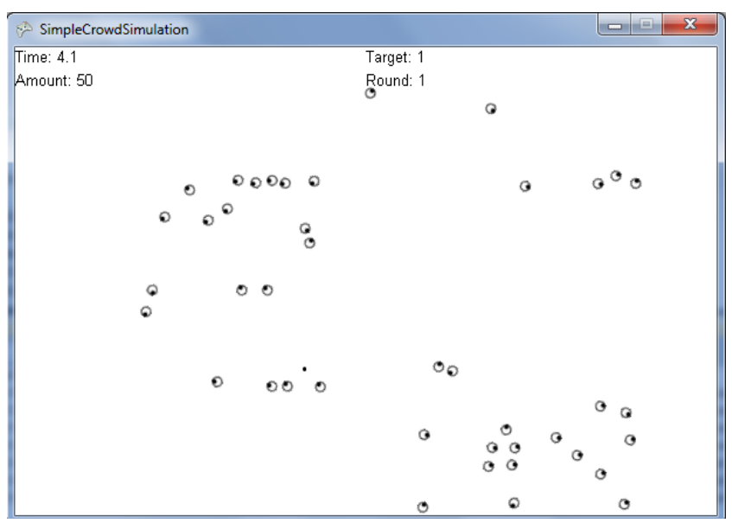
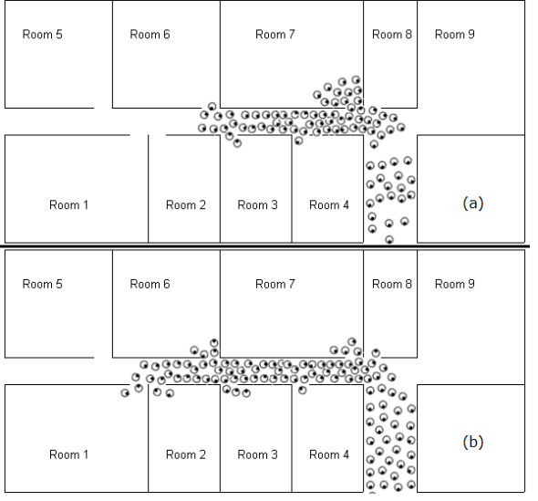
Evaluate Sun’s model (2014) and what it lacks and how other studies can enhance
This model is developed on Microsoft XNA framework
Advantage: configurability for agent’s attributes and extensibility on behavior libraries.
Limitation:
Crowd dynamic such as turbulence and stampede could not be simulated. Agents could not be overlayed.
Lack cognitive architecture to illustrate how and why a behaviour is chosen.

Slide 8
CROSS: Modelling Crowd Behavior with Social-Cognitive Agents (Wijermans, 2013)
- This generic framework models Crowd behavior in a Simulation with Situated individuals
This framework is developed based on Cognitive architecture (Anderson,2007) and Physiological cognition structure (Newell, 1990)
This framework is developed by Repast Simphony agent-based framework (Java-based)
This framework is studied for a Party case study
In Physiological:
Ticker time to go to toilet
Ticker time for eating
Toilet, and eating positions are in POIs of agents
In Cognitive architecture of an agent:
Memory:
Goals: safety, social, individual, or subsistence to satisfy Physiological factors
Fact: Area fact (recognise POIs), personal fact (friends, leaders). Behaviour fact let us know expectation it would be to perform a particular behaviour
Behaviour Rules: for walking, running, dancing
Process:
Perception:
physiological update: detect density, arousal alert in 1000 ticks
Memory update: update Goal dominance for goals from physiological update.
Notes:
It also has just exhibited a new version of C language to perform real-time simulation with high parallel computing.
Repast simphony can easily developed parallel thread, life cycles.
Environment creator, obstacles, and agents. Has a function to generate agents and ticker to move.

Slide 9
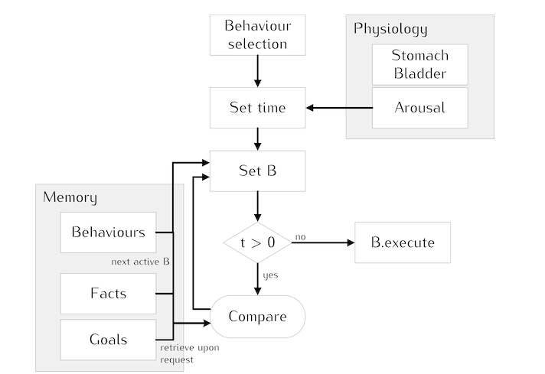
CROSS: Modelling Crowd Behavior with Social-Cognitive Agents (Wijermans, 2013)
Behaviour Selection Process

Slide 10
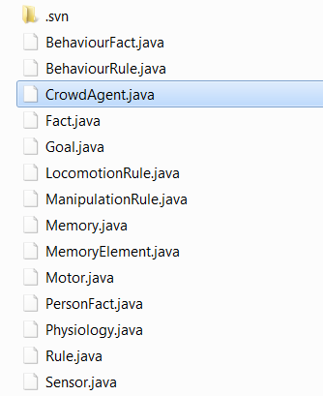
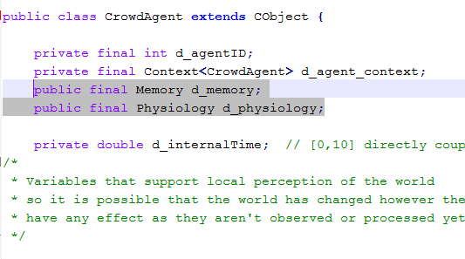
Evaluate about CROSS: Modelling Crowd Behavior with Social-Cognitive Agents (Wijermans, 2013)
Code snippet
Advantage
Propose a well-organized generic framework to integrate cognitive architecture How people thinking and why a behaviour is chosen by internal process.
Each situation will be defined with other factors for physiology and memory element

Slide 11
Introduction to Problem 1
Human decision making for route choice takes place simultaneously at three levels including strategic, tactical, and operational levels: (Hoogendoorn, 2013, 2002)
Strategic: a pedestrian selects his best-planned route among the collection of options towards to a known destination. The selected route could be the shortest or most familiar paths in pedestrian’s mental map.
Tactical: the capability towards re-routing adaptively into faster routes in case of congestion or high densities
Operational: accelerating, decelerating, stopping.
On fishing school study for route choice Individuals have to balance personal information (their own pass experience), potentially conflicting social information, and group cohesion to minimize isolation risk. (Couzin, 2013)
On ant study for route choice ant select more bridge trail (longer but faster) than keep forest floor choice after four month experiment (Loreto, 2013)

Slide 12
Adaptive temporal route choice
Current crowd models lack the simulation ability on the incorporation between cognitive architecture and route choice decision making. Cognitive information that could be adopted and learned from surrounding environment and other agents over the time.
Behavior selection process in CROSS model only offers the ability to identify goal and its behavior rule that are satisfied current physiological demand. Behavior rules are pre-defined and unchanged in CROSS model.
Simulation scenarios for temporal decision making of agent A in two corridor environment:
1st phase: Agent A sees agent B in forward direction in the same corridor 1, he takes over and reach exit. Agent A will put info agent B in his memory (New Fact 1) and update new possible acceleration in knowledge and the duration from his original position to exit door (New Rule1)
2nd phase: Agent A see another group of two agents C,D in forward direction in the same corridor 1, all rules can not satisfy him, he decelerates and follows agents C,D to exit the corridor. Agent A will put information of agents C,D in his memory (New Fact 2). (Percentage of deceleration adjuster when unsuccessfully taking over) –New Rule2
3rd phase: Agent A starts and go to corridor 2 and face exit gate. Agent A put corridor 2 to exit gate into his memory. -New Fact 3
4th phase: Agent A see agent B again by checking his memory, he keep a closer distance to agent B and go to exit gate together (use New Fact1)
5th phase: Agent A see another group of two agents C,D. When rules (included new rules 1,2) are not satisfy, he select corridor 2 (use New Area fact 3).

Slide 13
Questions for Problem
How to model new knowledge extracted from observed phenomena for agents.
How to self-create new behavior rules, and memory, goal, fact.
How to simulate motion decision levels of agents based on above knowledge over the time.
Find out validation mechanism from actual data for above model
Importance why do we need, where do you go with that
Practically
Why can I sudden do it
Why am I person, key to do it
What we key door idea to help solve that, why does it resvoable.
Notes:
How long has current crowd behavior occurred to make pedestrian have to switch to new route.
Self learning will auto put new knowledge learned from observed phenomena into knowledge component. Knowledge component will remember threshold and which people should follow. Memory remembers threshold for situation and update threshold if the result is fail comparing planned route and duration. Memory save other people’s information with a hierarchical tree information. Personal characters (leadership, willingness to follow, stay in a group, being affected by points of interest, desired distance from each other, desired distance from obstacles)

Slide 14
Reference
Georgeff, M.P., Ingrand, F.F, Decision-Making in an Embedded Reasoning System, 1989. International Joint Conference on Artificial Intelligence
Zoumpoulaki, A. A multi-agent simulation framework for emergency evacuations incorporating personality and emotions, 2010. Artificial Intelligence: Theories, Models and Applications, Lecture Note.
Anderson, J.R. How can the Human Mind Occur in the Physical Universe, 2007. New York: Oxford Press.
Newell, A. Unified teories of cognition (3rd Edition), 1990. Cambridge: Harvard University Press.
Pelechano, Crowd Simulation Incorporating Agent Psychological Models, Roles and Communication, 2006. In proceeding of 1st Workshop of Crowd Simulation.
Couzin, Visual attention and the acquisition of information in human crowds, 2011. In PNAS
Sun, A Configurable Agent-Based Crowd Model with Generic Behavior Effect Representation Mechanism. 2014. Journal of Computer-Aided Civil and Infrastructure Engineering
Wijermans, CROSS: Modelling Crowd Behavior with Social-Cognitive Agents, 2013. Journal of Artificial S ocieties and Social Simulation
Couzin, Both information and social cohesion determine collective decisions in animal groups, 2013. In PNAS
Loreto, Foraging ants trade off further for faster: use of natural bridges and trunk trail permanency in carpenter ants, 2013. In Naturwissenschaften
Hoodgendoorn,. State-of-the-art crowd motion simulation models, 2013. Transportation research part C, Volume 37

